Slide 1
Exam 1
In class (Oct. 2), on ELC
Part 1: 25 Multiple Choice, True/False questions
Part 2: SQL questions.
Close-book, close-note

Slide 2
Coverage
Class slides
Homework assignments 1-2
Book chapters 1-6

Slide 3
DBMS: Basic Concepts
Relation/entity/table, attribute/column/field
Identifier/primary key, foreign key, relationship
Table structure, data record, data type, constraints in the table (e.g., referential integrity)
Data definition language (DDL): create, alter, drop…
Data manipulation language (DML): select, insert, update, delete

Slide 4
SQL: Key Issues in Developing Queries
Apply general SQL syntax
Pay attention to data structure
What relationships are involved?
How to JOIN tables?
At which level to apply aggregation?
Use subqueries

Slide 5
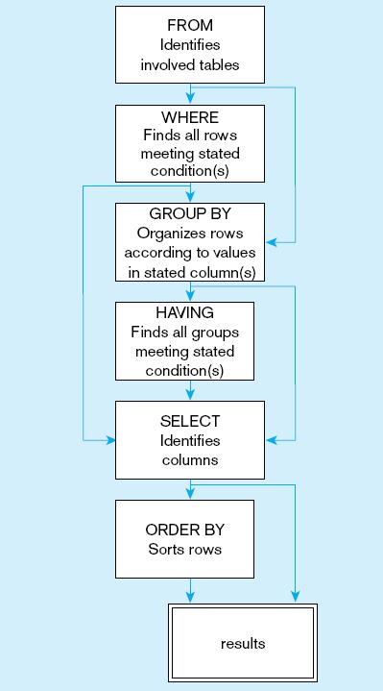
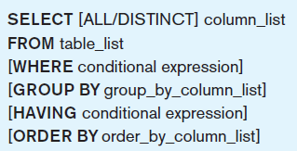
General Syntax of the SELECT statement

Slide 6
General SQL Syntax: SELECT
Simple query: use SELECT and FROM
Criteria: use WHERE
Simple criteria, using comparison operators
Compound criteria, using Boolean operators
Some useful clauses: IN, BETWEEN
Computed fields: in SELECT
Built-in-functions: use GROUP BY and HAVING
Sort results: use ORDER BY
Regular expression (REGEXP, ^, …), wildcards (%, *, _, …)
Distinct
Limit

Slide 7
Data Structure
Single-table
Multi-table
1-TO-Many relationship (including 1-To-1)
M-TO-M Relationship
JOIN
INNER JOIN
OUT JOIN (LEFT JOIN and RIGHT JOIN)
Single-table recursive
1-TO-Many relationship (including 1-To-1)
M-TO-M Relationship
JOIN

Slide 8
JOIN: Key Issues
Primary keys and foreign keys
What tables are involved
Where to put the INNER JOIN conditions?
In FROM clause or in WHERE clause?
INNER JOIN, LEFT JOIN, or RIGHT JOIN?

Slide 9
Subquery: Key Issues
Correlated versus uncorrelated subqueries
The use of a correlated subquery avoids a JOIN operation
Correlated subqueries are always in the WHERE clause
Where to include subqueries?
WHERE clause or HAVING clause: use as part of a condition
In FROM clause: use as a “table”
In SELECT clause: use as part of a computed field

Slide 10
DML & DDL
DML
CREATE TABLE
INSERT INTO
DELETE FROM
UPDATE TABLE

Slide 11

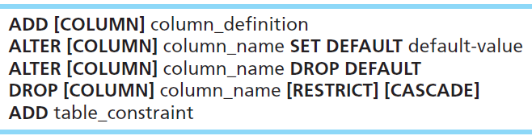

Changing Tables
ALTER TABLE statement allows you to change column specifications:
Table Actions:
Example (adding a new column with a default value):

